Slide 1
ACCESS-CM2 Performance in Climate Simulation
ACCESS Coupled Modelling Team
CSC/CSIRO O&A

Slide 2
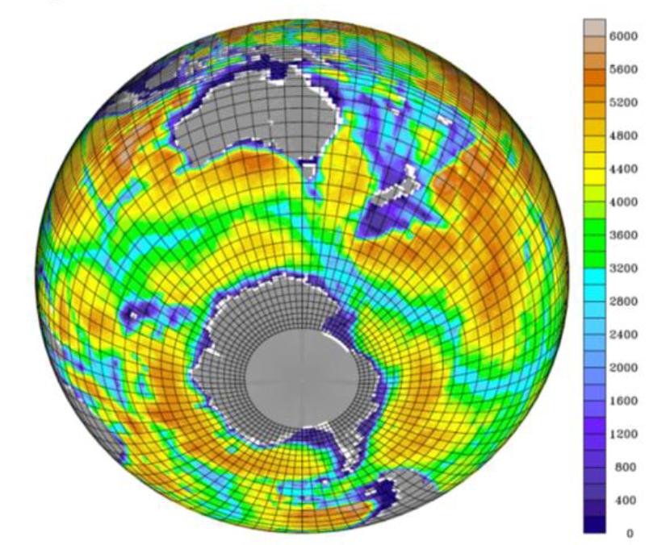

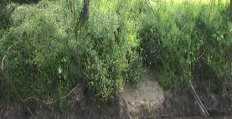
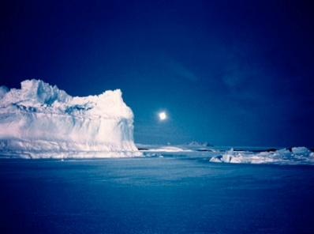
Australian Community Climate and Earth System Simulator Global Climate Model ACCESS-CM2
ACCESS Coupled Climate Modelling system
Atmosphere
Met Office UM10.6/GA7.1
Terrestrial
CABLE2.x
or Jules
Coupler
OASIS3-MCT
Ocean
and sea-ice
MOM5 and CICE5
Ocean and sea-ice
Atmospheric/land resolution
1.25° N/S; 1.875° E/W (“N96”)
85 levels vertically
Ocean component grid and bathymetry
(showing every 4th grid row zonally and meridionally).

Slide 3
MOM5 in our Coupled Models
ESM: MOM5 + BGC (WOMBAT)
CM2: MOM5
OM2-CM2: MOM5 (in development)
On behalf of Peter Dobrohotoff

Slide 4
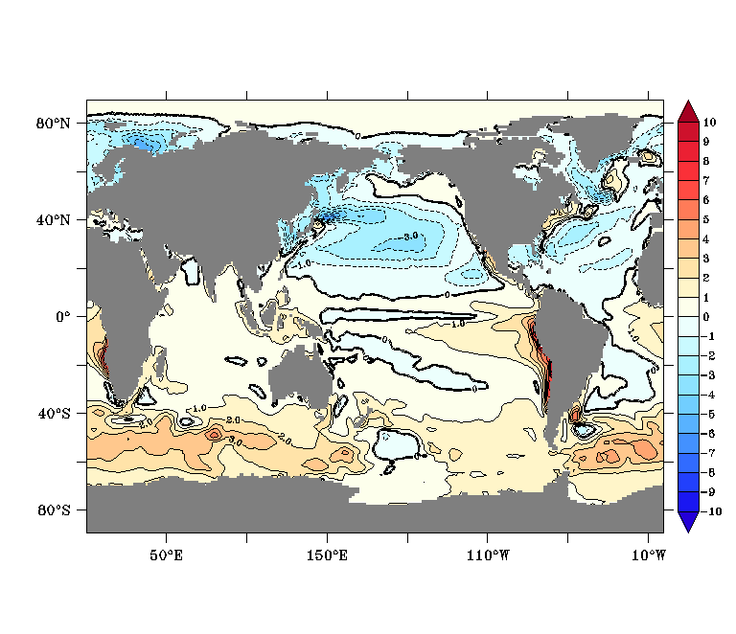
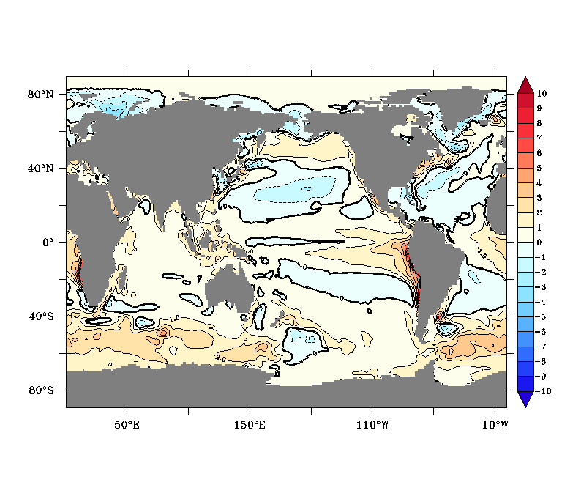
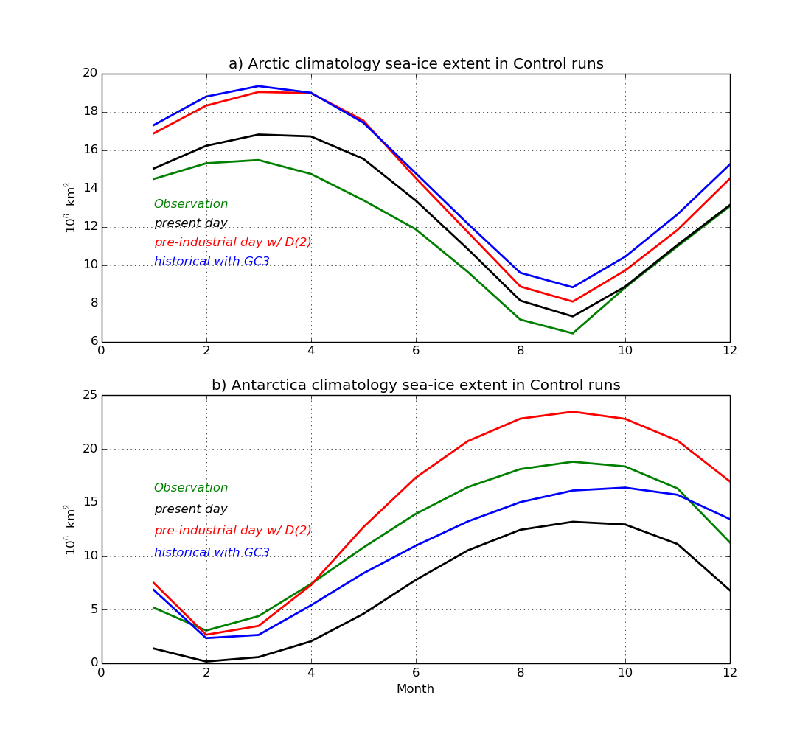
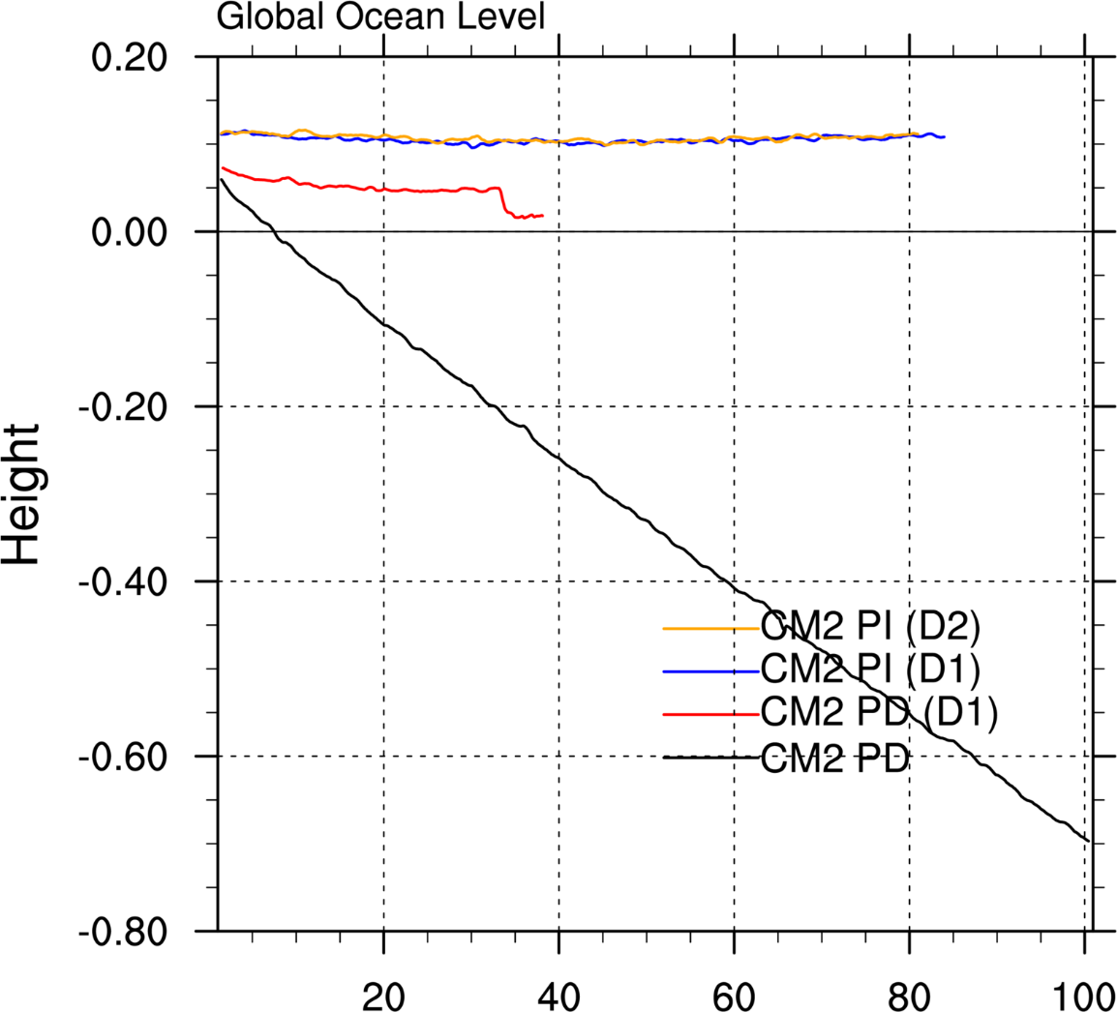
Long-existing issues: SO Warm Bias/little summer sea ice, Water Mass Imbalance
ACCESS-CM2 with GA7 (PD run 30-yr mean)
ACCESS-CM2 with GA7.1 (PD run 30-yr mean)

Slide 5
“Fixing” the Southern Ocean Warm Bias and Global Ocean Water Loss
By
Discharging the diagnosed increment of iceshelf mass over Greenland and Antarctica into ocean surface water off Greenland and Antarctica, respectively, the land ice melting (as iceberg calving and ice shelf basal melting) ➔
freshening the surface water
cooling the surface water
Siobhan’s talk

Slide 6
Preliminary, Global Scale Assessment of the ACCESS-CM2 PI spin-up runs***
Sea Surface Features
SST/SSS evolution and global biases
Precipitation pattern
ENSO
Energy and Mass balance
TOA and ocean surface energy balance
Global sea level evolution
Sea ice
Distribution pattern
Ice extent climatology
Ocean interior water property
Vertical T/S feature
Vertical T/S bias evolution
Ocean dynamic feature – water mass transport
Meridional Overturning Circulation
ACC transport
***Jules version spinup runs
Ar676 (D(0), 200 yrs) ➔ av630 (with D(2), as for at658), up to yr 420
At658 (D(2)), up to 220 yrs, (cri=0.3)
At659 (D(2)), up to 230 yrs, (cri= 0.15)
***CABLE version is still under test……
Siobhan’s talk

Slide 7
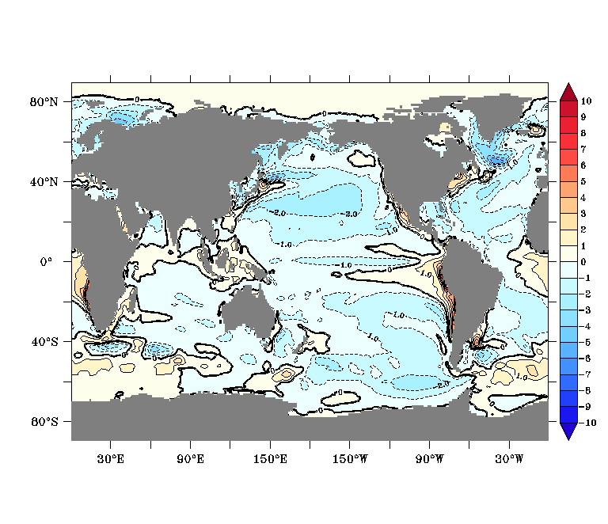
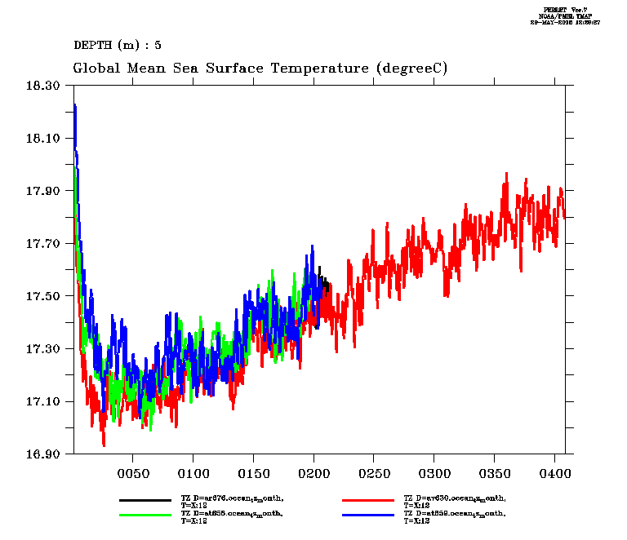
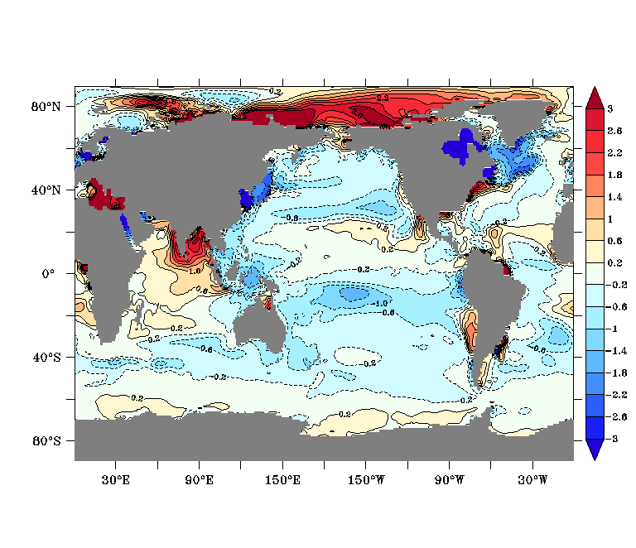
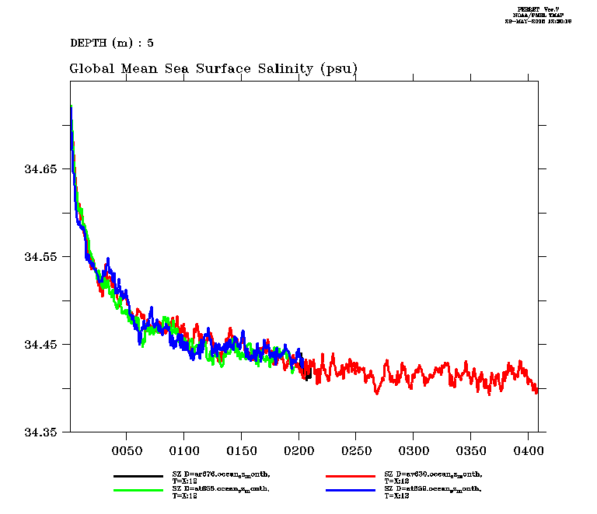
Sea surface feature: Annual mean SST/SSS biases (yrs271-300 of av630) and global annual mean evolution
SST
ar676
av630
at658
at659
SSS

Slide 8
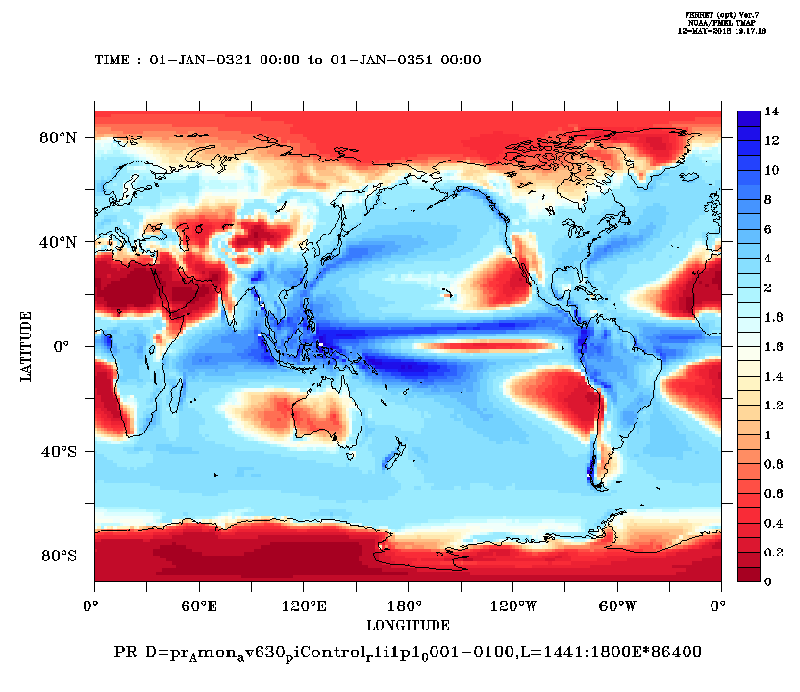
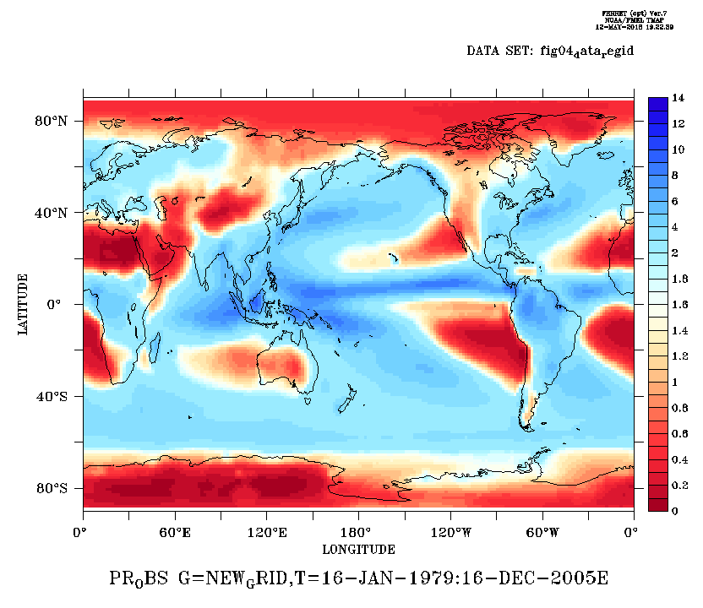
Sea surface feature: Precipitation Pattern
Av630 yrs 321-350
OBS. GPCP 1979-2005

Slide 9
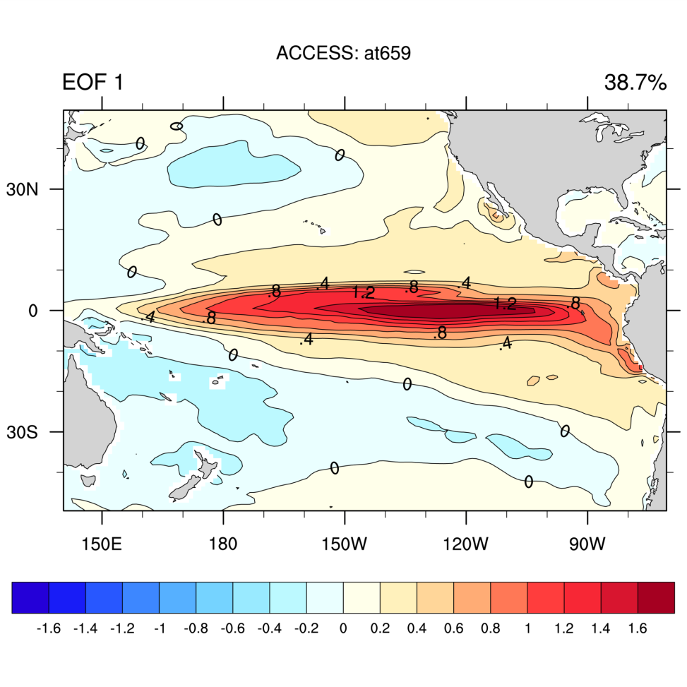
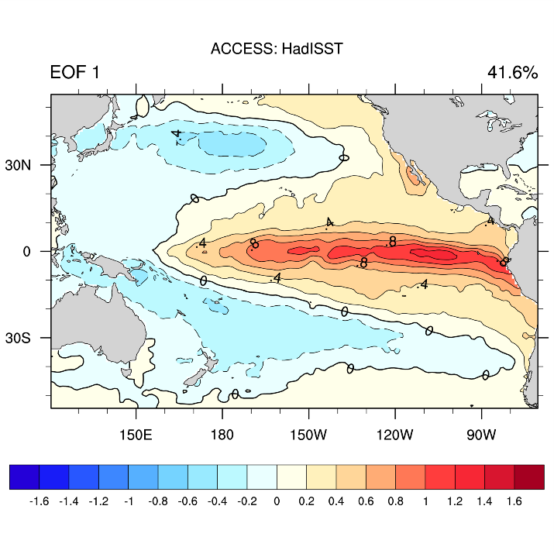
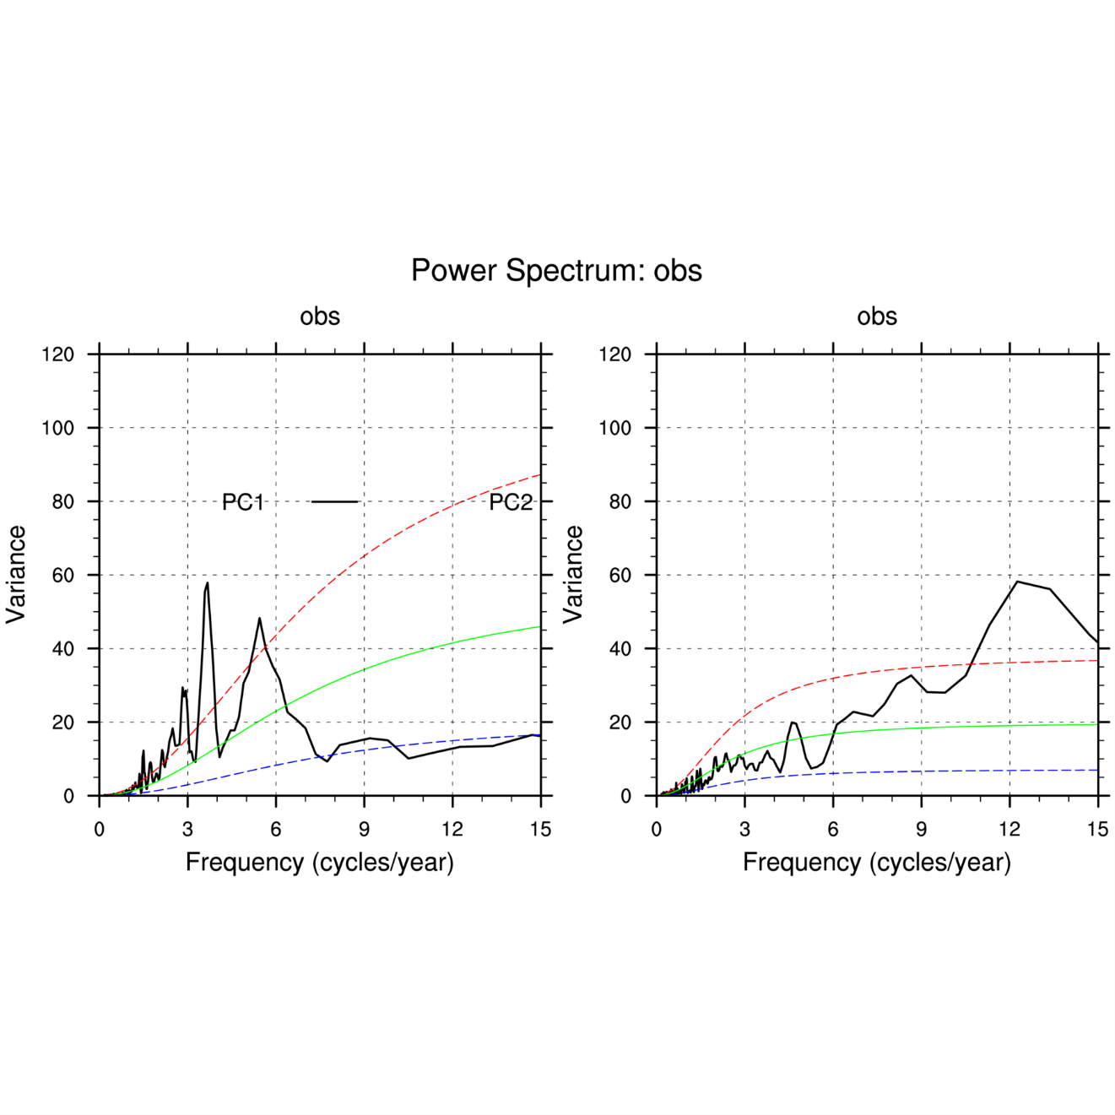
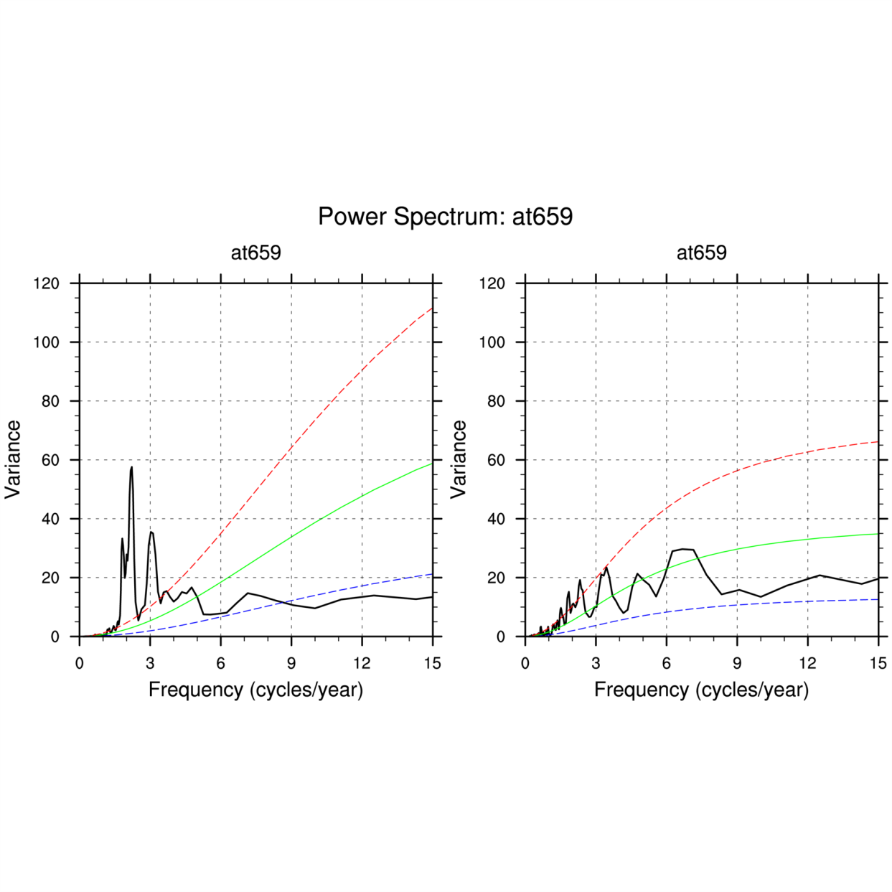
Surface Feature: ENSO Pattern and Power Spectra
Had-SST
at659
Period (year)
Period (year)

Slide 10
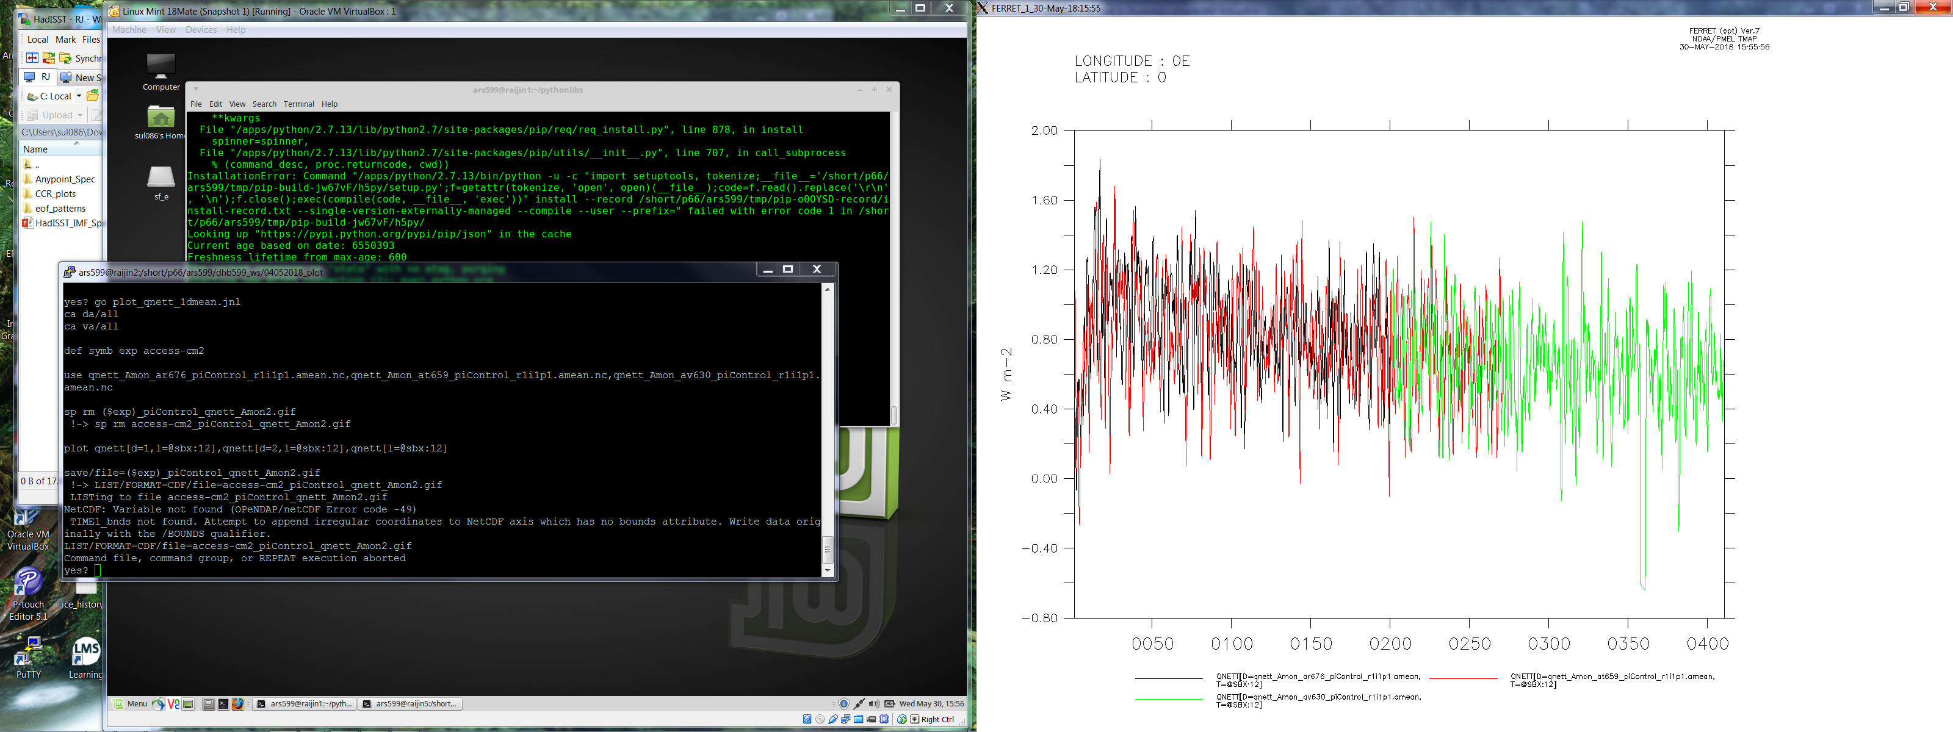
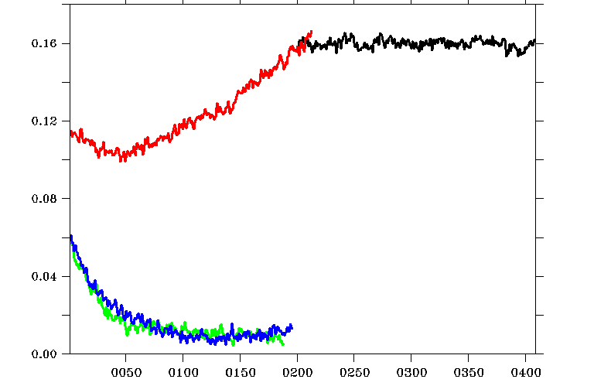
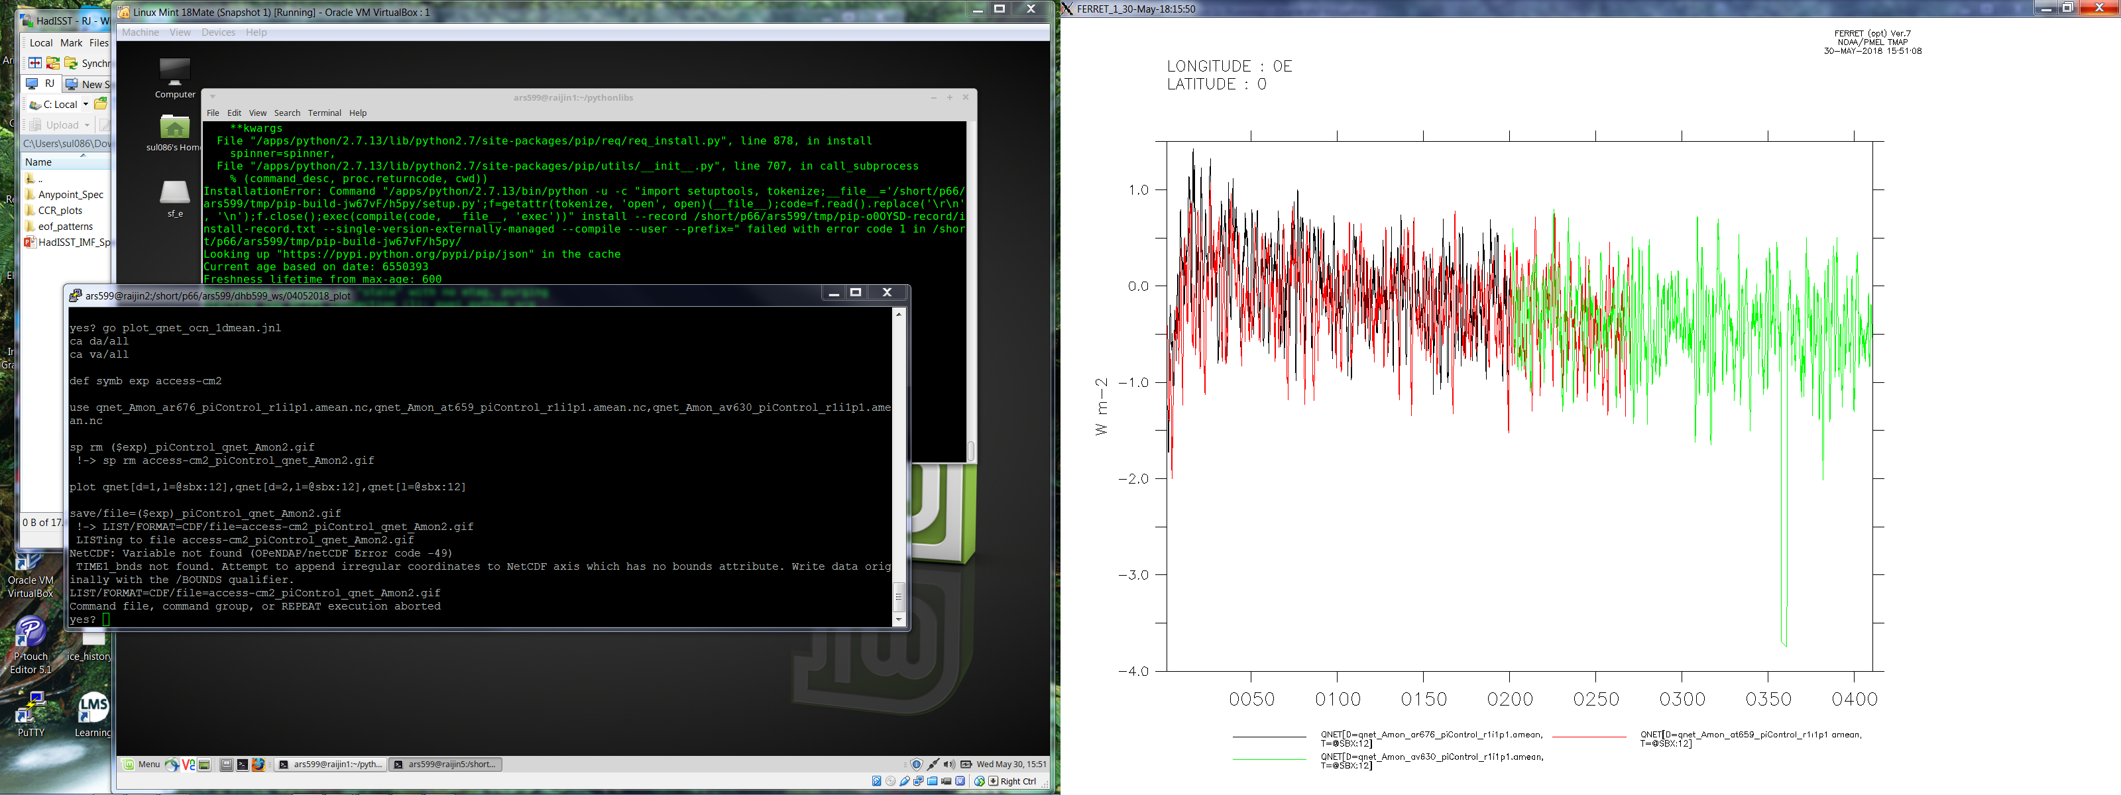
Energy and Mass Balance: TOA/Ocean surface energy balance and Global sea level evolution
TOA
Global mean SSL evolution
ar676
av630
at658
at659
Sea surface

Slide 11
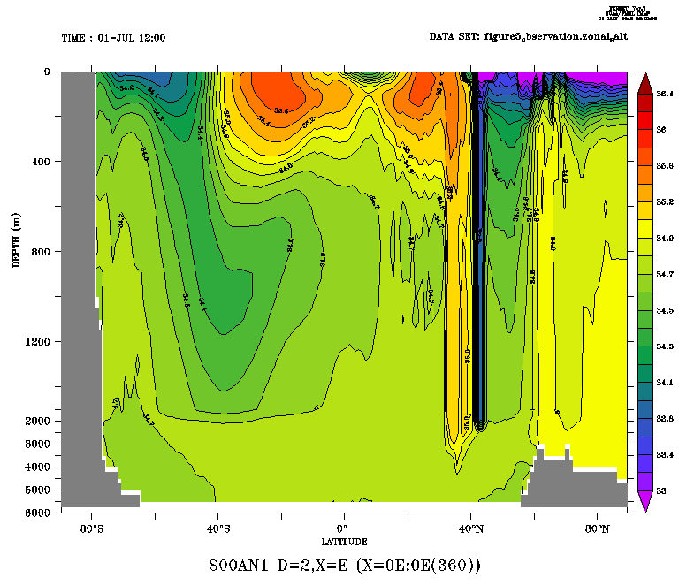
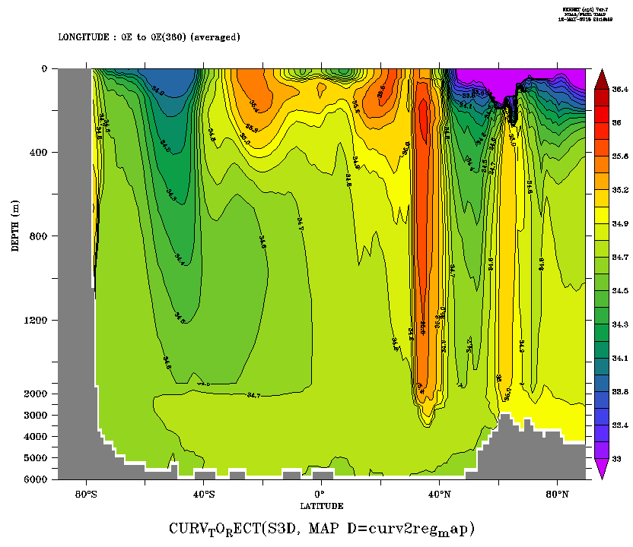
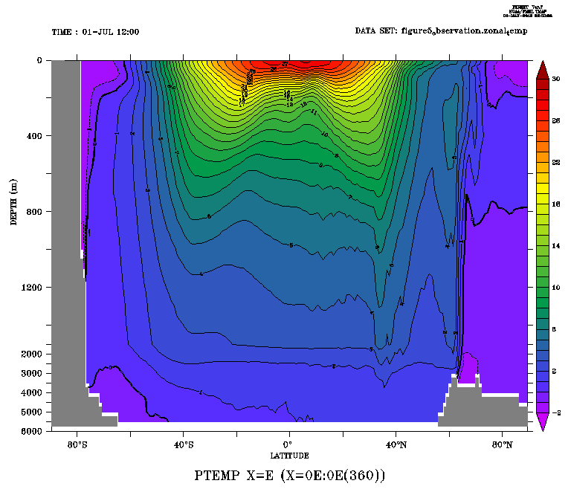
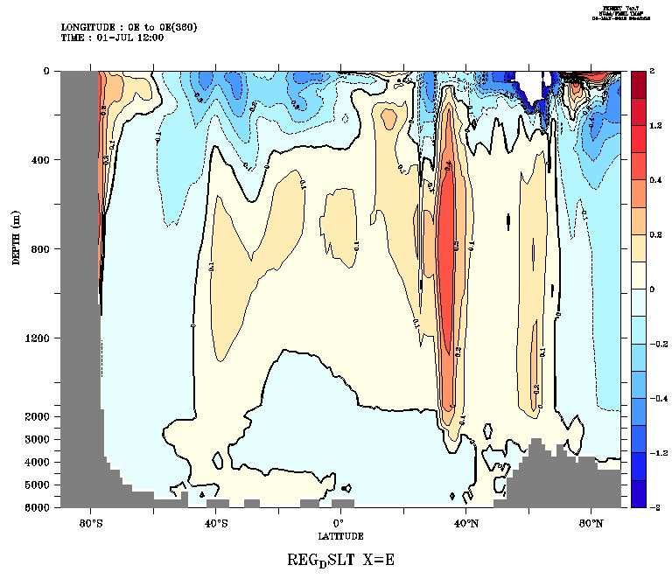
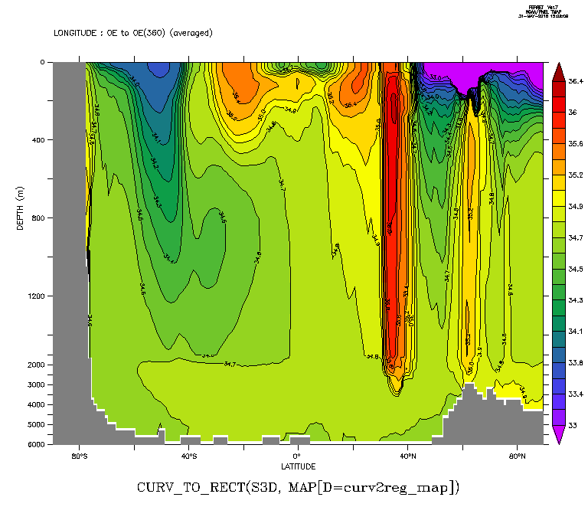
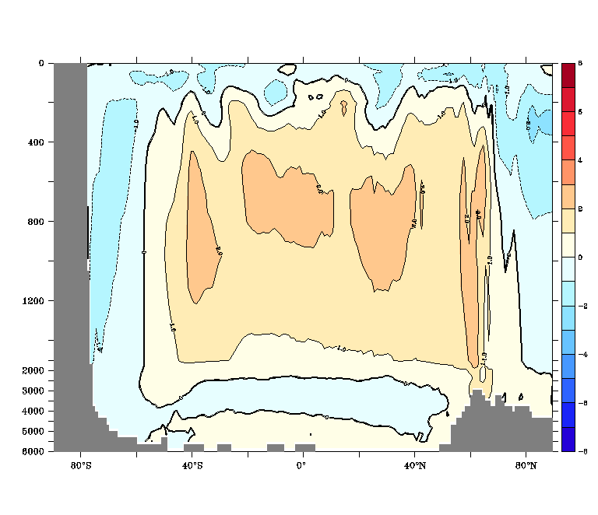
Ocean interior water property Zonal mean S/T pattern and biases
Obs
at659- yr171-200
Obs
Biases
Av630 yr 390-420
Biases

Slide 12
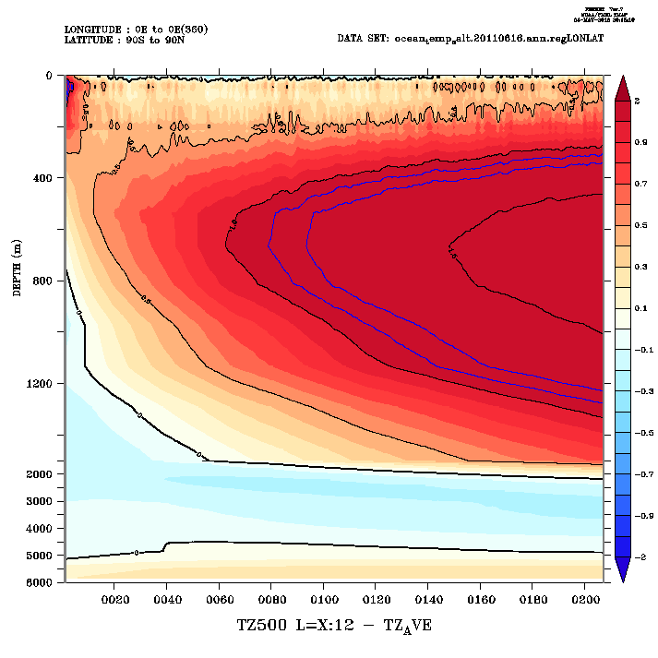
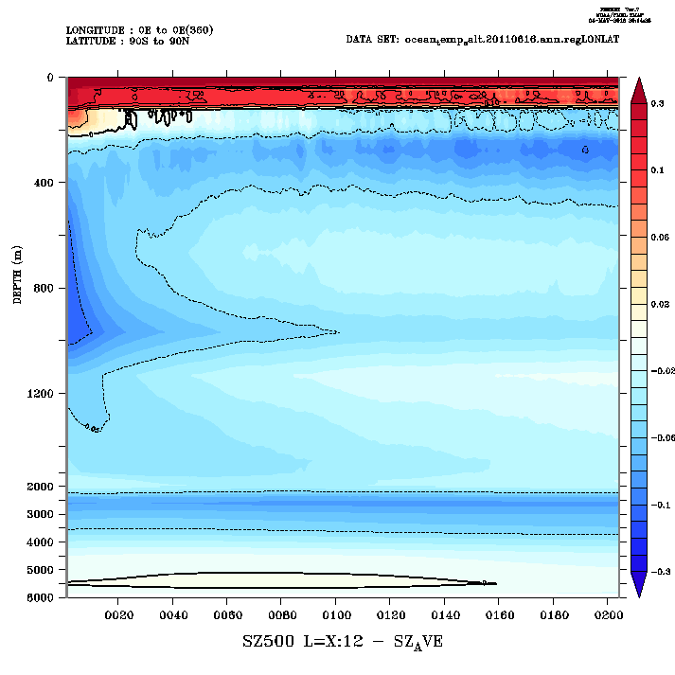
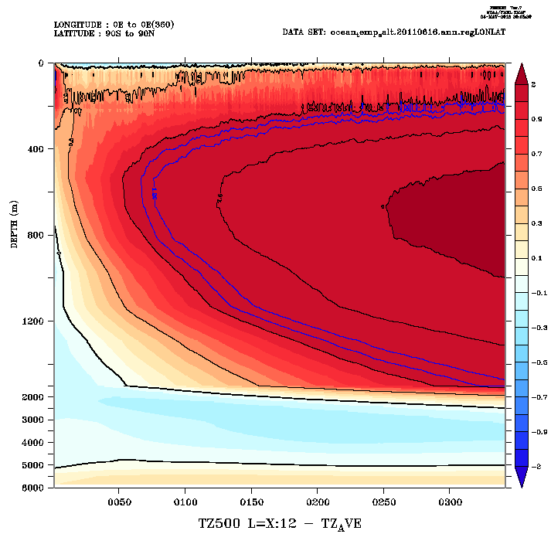
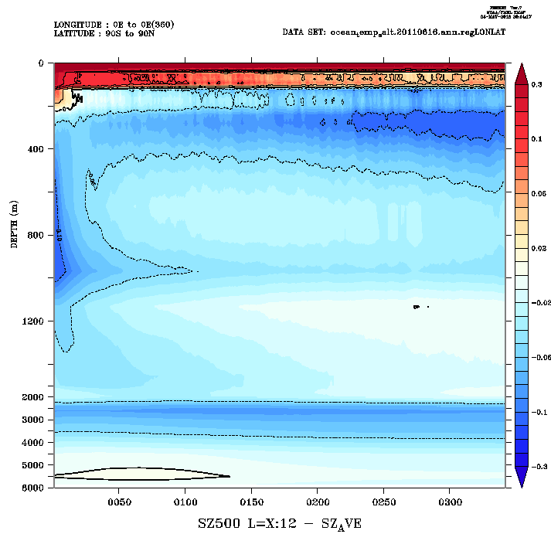
Horizontal mean T/S biases evolution in at659 and av630
Temp
Salinity

Slide 13
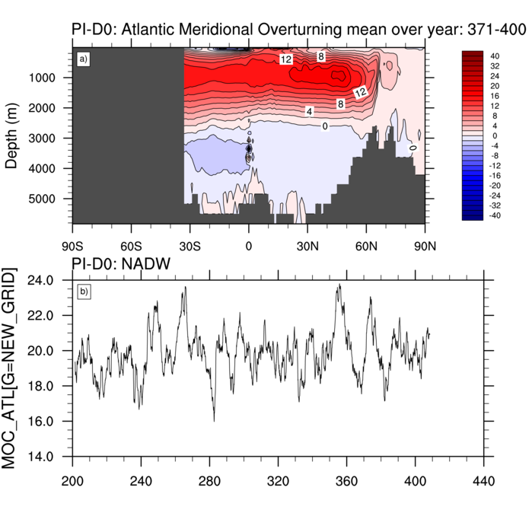
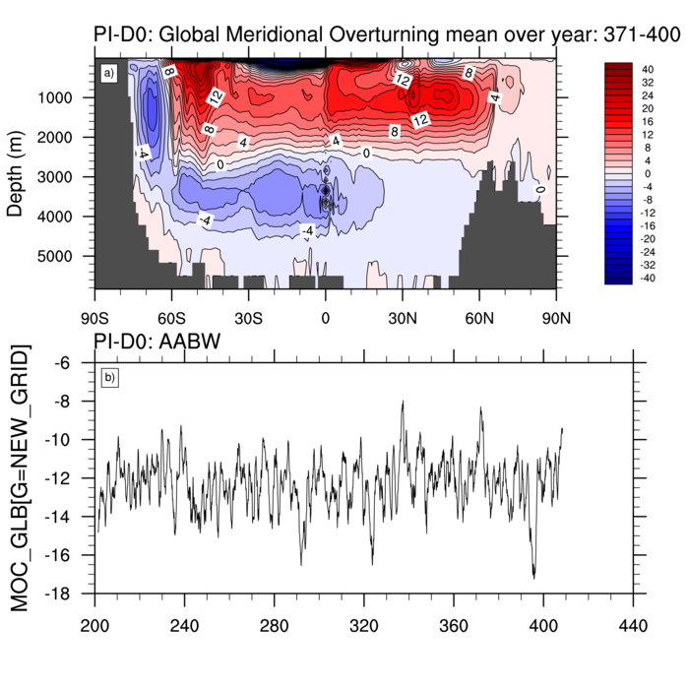
Ocean Dynamic Feature MOC Patterns, and AABWF and NADWF evolution (Sv)
NADW (ar676 + av630)
AABW (ar676 + av630)

Slide 14
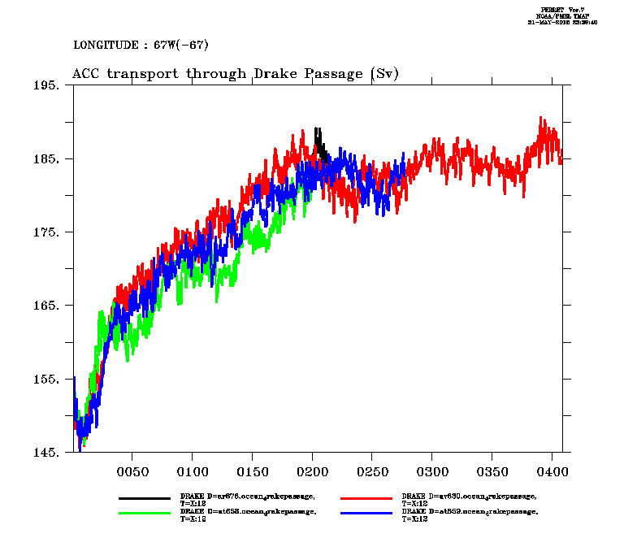
Ocean Dynamic Feature ACC transport through Drake Passage (Sv)
ar676
av630
at658
at659

Slide 15
Summary:
ACCESS-CM2 for CMIP6 (NESP ESCC Hub Project 2.1: Preparing ACCESS for CMIP6)
ACCESS-CM2 is the new generation of ACCESS coupled model with much more sophisticated atmospheric configuration, especially higher vertical resolution and full aerosol scheme, along with a range of physics/dynamics upgrades (in comparison with ACCESS1.x models for CMIP5)
Therefore ACCESS-CM2 is significantly more computationally expensive and takes a lot more data storage
The Jules version of ACCESS-CM2 simulates reasonable PI climate and is “close” to starting official CMIP6 experiments (PI control, historical,, 4xCO2 etc.)
The CABLE version of ACCESS-CM2 is close to finalizing configuration .

Slide 16
Summary:
Risk for CMIP6 delivery – problems beyond control of the ACCESS-CM team
NCI Computing efficiency ➔ question on completion of CMIP6 exps: ideally 5 years/day, but in reality 1~2 years/day because of long queuing……
CABLE version spin-up (?)
Data storage shortage
Human resource shortage

Slide 17
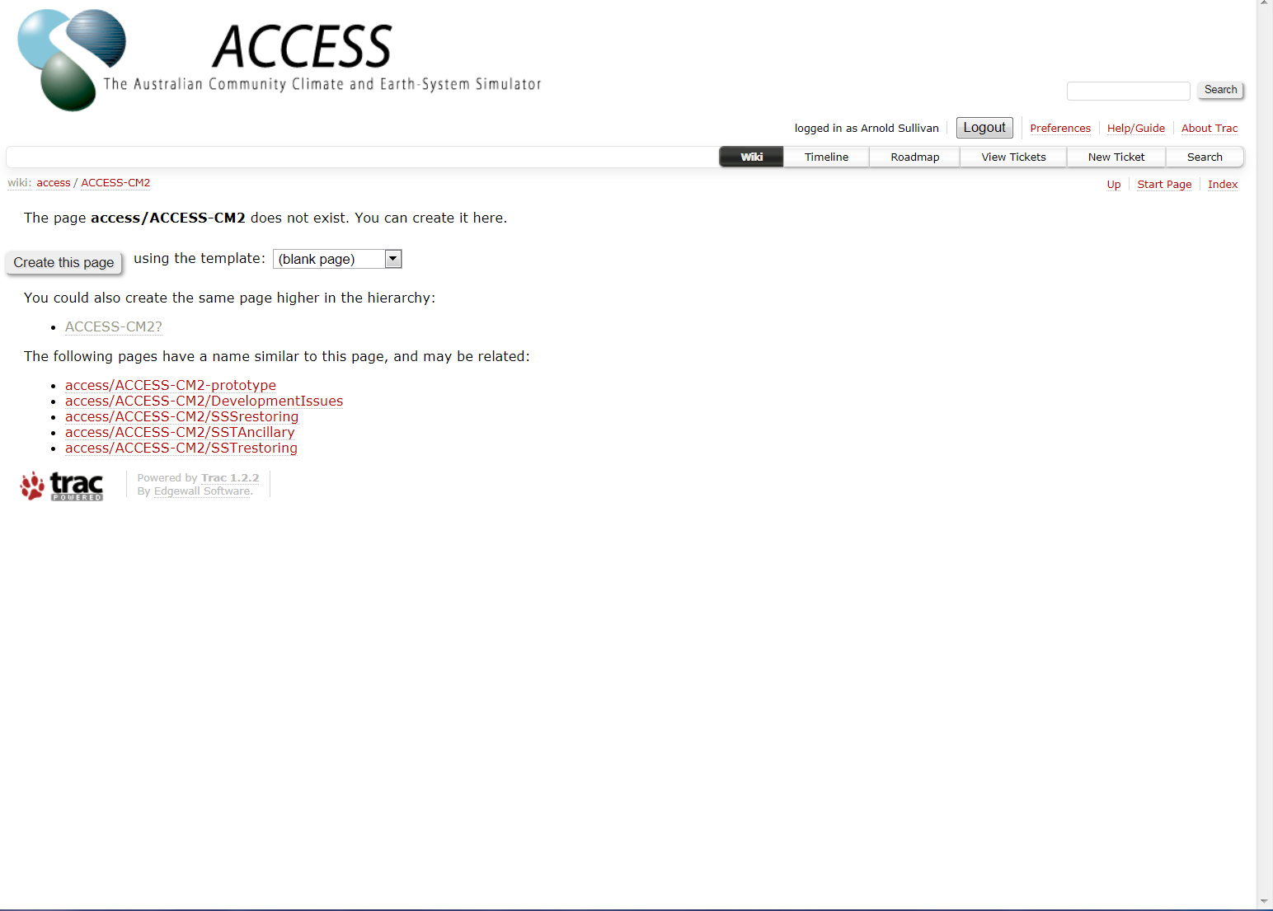
ACCESS-CM2 Wiki Page
Convert NetCDF to UM ancillary file format (Ben Ng)
Set Up SSS restoring experiment (Ariaan)
Set Up SST restoring experiment (Christine et al.)
https://accessdev.nci.org.au/trac/wiki/access/ACCESS-CM2

Slide 18
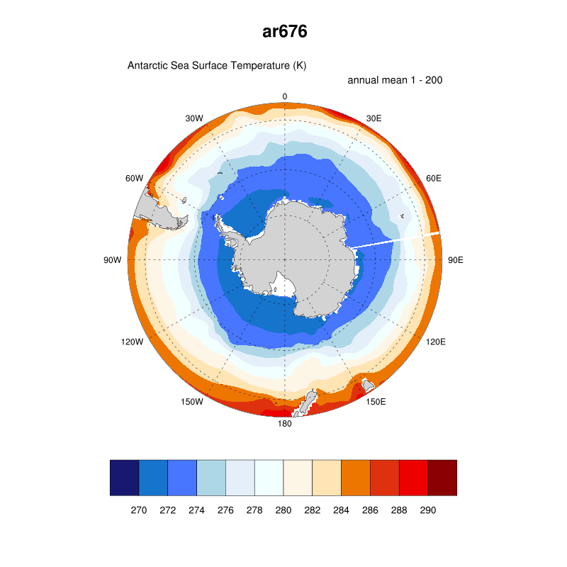
Post Processing
Installed and Prepared by:
Tim Erwin, Kate Snow & Claire Trenham
https://docs.google.com/document/d/1bbgRqxCIszDHBMrgS9i2HmwBmj_wlyTbp3k8LF2zyWI/edit
Test Directory:
/short/p66/ars599/post_processing/ESMVal/ESMValTool/test-nml
namelist_atm.xml
namelist_ocn.xml
namelist_seaice2.xml
Observation on the way!
ESMValTool

Slide 19
Thank you!
The Australian Community Climate and Earth-System Simulator (ACCESS)
Dave Bi, Research Scientist, CSIRO O&A
t +61 3 9239 4507
e dave.bi@csiro.a

Slide 20
Features and History of ACCESS-CM2
Features
New Versions of All Components:
Atmosphere: N96 UM10.6/GA7.1 (85 levels, active aerosol)
Land: CABLE2.x (currently Jules)
Ocean: 1-deg MOM5
Sea ice: 1-deg CICE5 (multi-layer)
Coupler: OASIS3-MCT (real parallel coupling)
New Framework/Control System:
Cylc-Rose (“easier” for general users)
History
2014/15 started from ACCESS1.4 framework ➔ Prototype version ACCESS-CM2 (with UM8.6/GA6)
2016 switched to Cylc-Rose ➔ Beta version ACCESS-CM2 (with UM10.3/GA7) [really tough year for CSIRO]
2017 upgraded UM to UM10.6/GA7.1 ➔ Official version ACCESS-CM2
Various delays because of strong dependence on collaborators’ delivery……
Just started tuning (mainly ocean and sea ice) for “acceptable” present day climate simulation
CMIP6 delivery depends on model performance and timing……

Slide 21
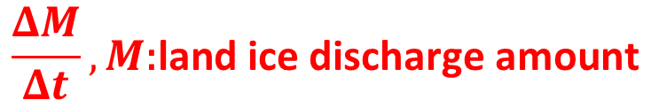
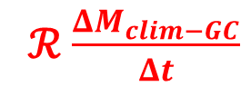
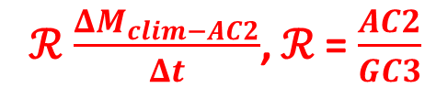
Iceberg Discharge Scheme Setting:
$$\frac{ΔM}{Δt}, M\text{:}\text{land} \text{ice} \text{discharge} \text{amount}$$
D(0): iceberg = 0:
“prescribed” even distribution but time-varying land ice discharged into oceans around Antarctica and Greenland as “iceberg melting”;
D(1): iceberg = 1:
use land ice discharge diagnosed from ar676 (D(0) run, yrs2-101) imposed on GC3.1 iceberg flux pattern but with each month "enhanced" by the AC2/GC3.1*** discharge ratio.
D(2): iceberg = 2:
following GC3.1 iceberg pattern and seasonality, with each month enhanced by the annual ratio of AC2/GC3 “discharge”
Note this option has "adverse" seasonality to D(0) and D(1), as shown below.
***GC3.1 NEMO iceberg flux climatology.
ℛ$\frac{ΔM_{clim−AC2}}{Δt}$, ℛ = $\frac{AC2}{GC3}$
ℛ$\frac{ΔM_{clim−GC}}{Δt}$
Notes:
D(1) and D(2) have identical annual discharge amount of land ice, as diagnosed from yrs 2-101 of the D(0) run.

Slide 22
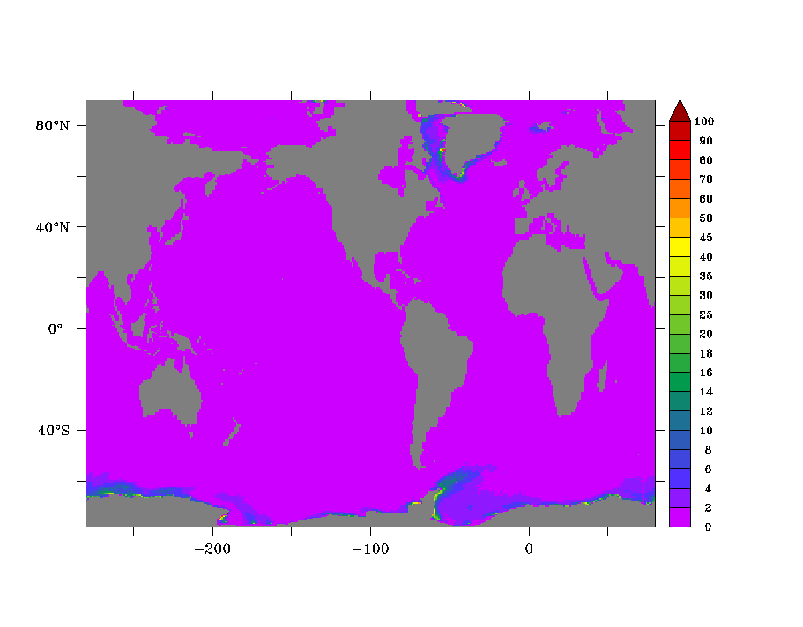
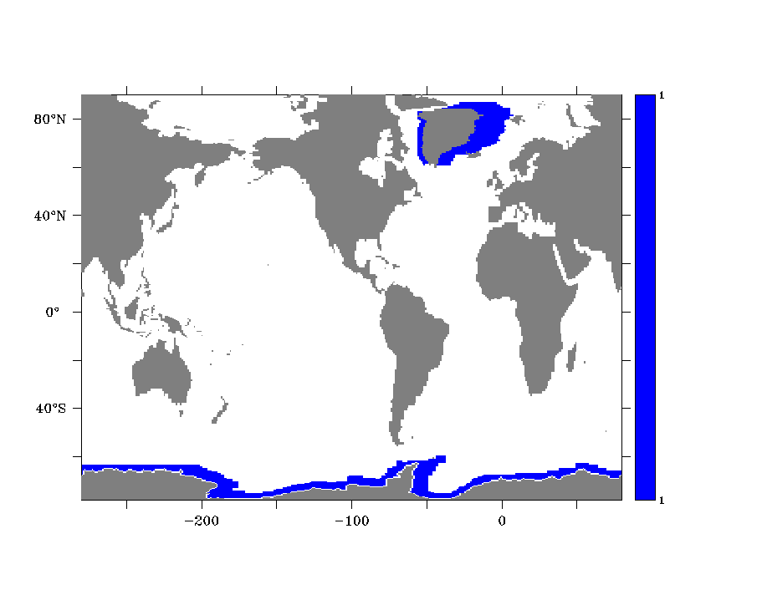
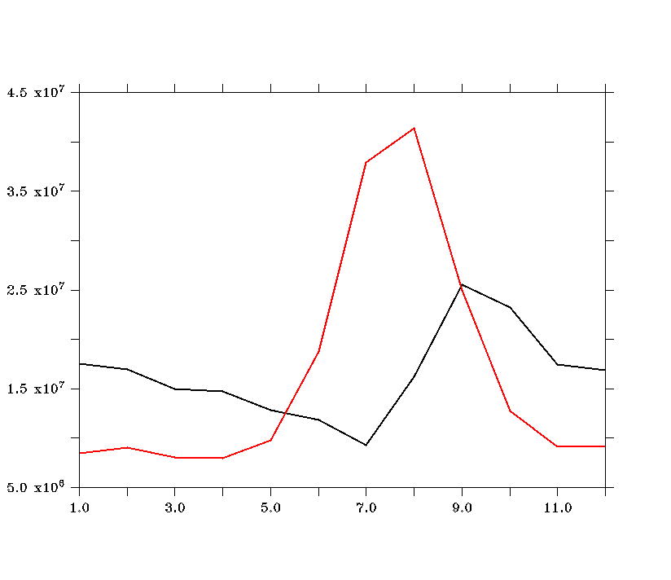
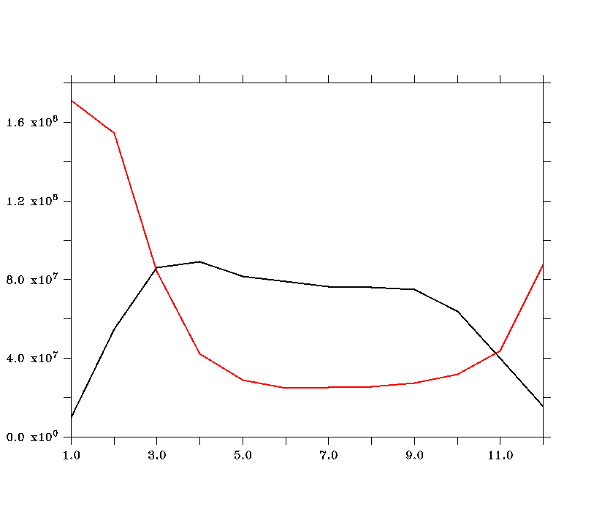
Iceberg Discharge Mask/Pattern and Amount
Ar676
At657 & at658
10⁻⁶ Kg m⁻² s⁻¹
At657
At658
Kg/ s
Notes:
Ar676 land ice discharge mask and at657-658 annual mean of land ice discharge rate.
White area
Red UM GC3.1 with NEMO iceberg climatology vs Black line is Ar676 diagnosed land ice discharge annual cycle. The sum of both are equal.
Red is more reasonable.
Refreshing rises the freeze point good for sea ice to form.
Melting will take away the heat which cause major cooling in Southern Ocean.

Slide 23
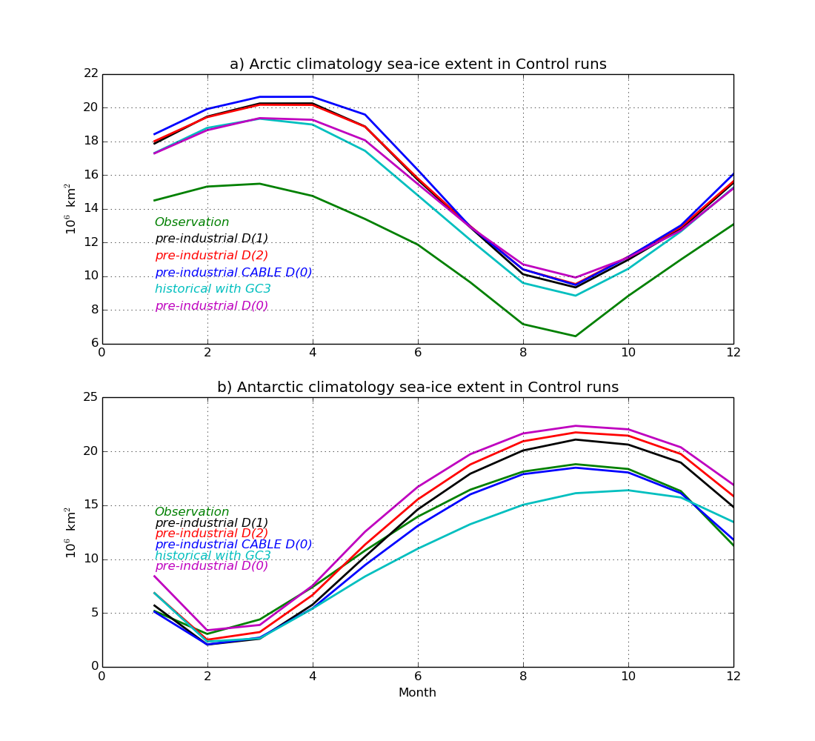
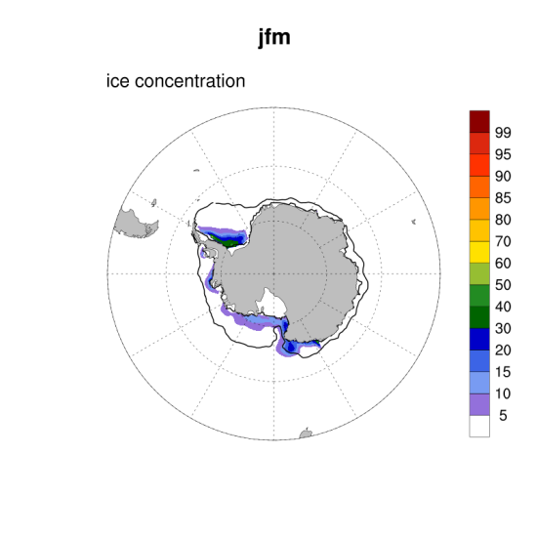
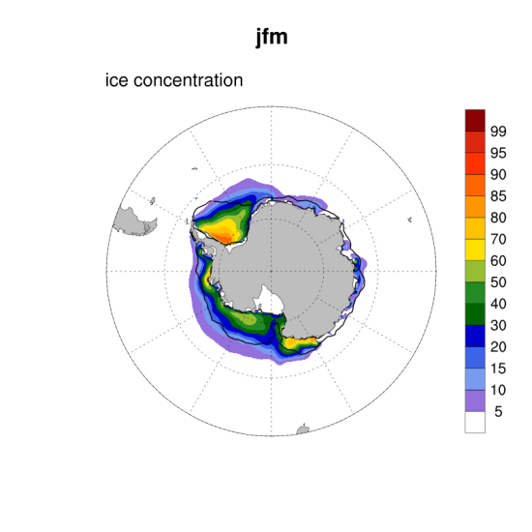
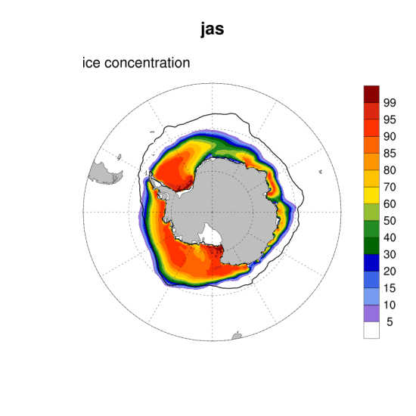
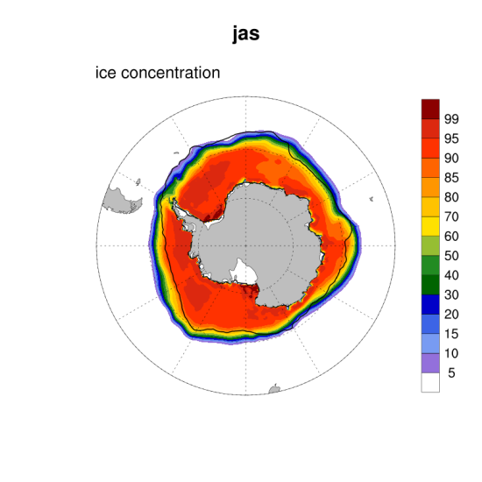
Sea Ice Southern Ocean sea ice climatology
al623
at659

Slide 24
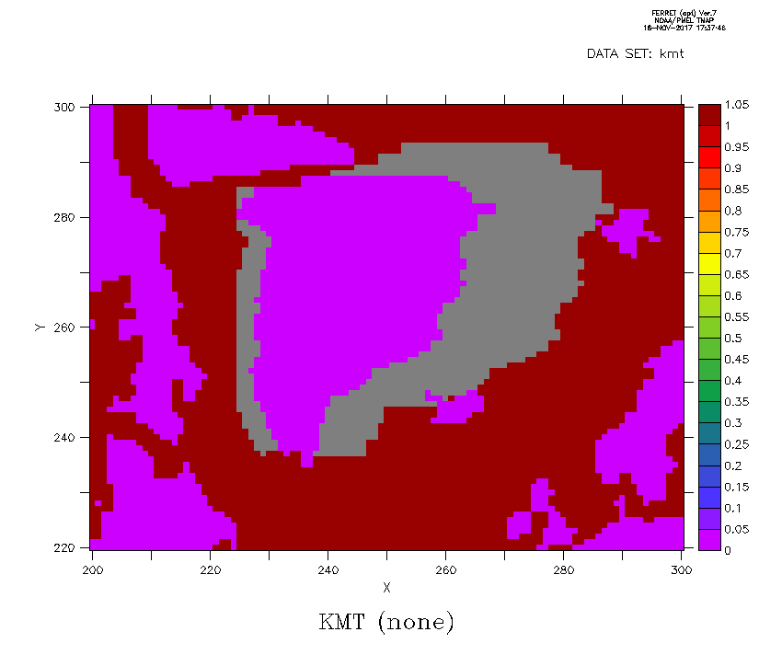
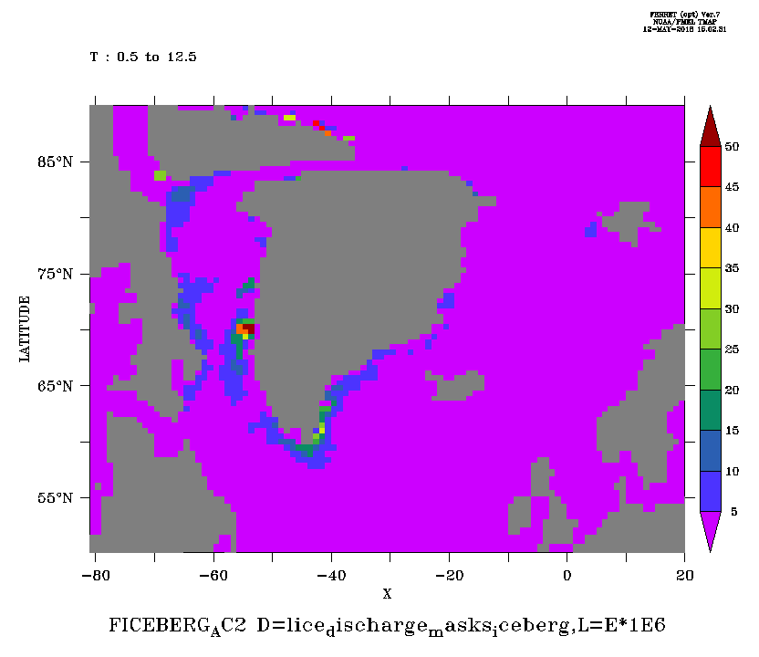
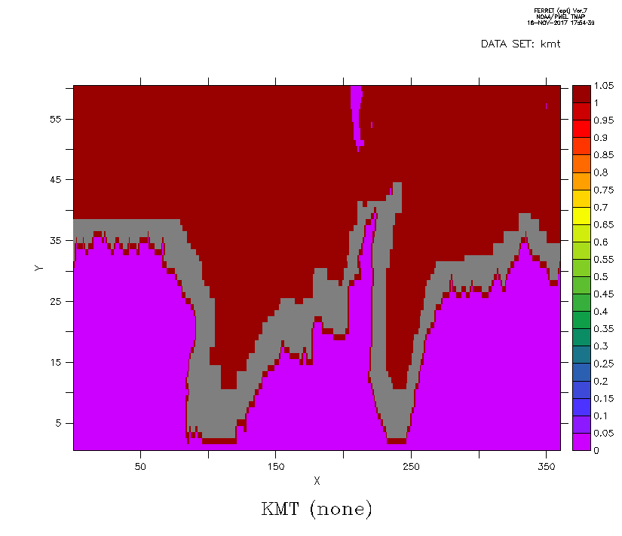

Land ice discharging off Antarctica and Greenland (Considered as water flux of iceberg calving)
Years 1-30 mean
FW flux (10⁻⁶ kg/m²/s)
Greenland:
PI (9.151)
(-3.056 W/m²)
Global mean:
PI (0.2795)
(-0.093 W/m²)
Antarctica:
PI (14.77)
(-4.933 W/m²)

Slide 25
Iceberg Scheme – Bi/O’Farrell
A “compensation” operation associated with the UM/Jules handling of land surface snow/ice (“land ice” hereinafter) accumulation.
The current UM/Jules system allows the land ice to be accumulated during the course of simulation. This is (I guess) because of the model lacking an efficient way to bring it (i.e., the increment of land ice) back to the ocean (where it comes from)—obviously the normal physical melt (resulting in runoff) is not enough in the model, and one can see the land ice diagnosed in the output increase (nearly) linearly all the time.
Consequently the oceans lose water all the time and sea level drops , linearly.

Slide 26
Iceberg Scheme – II
We have not seen such land ice build-up in ACCESS1.x, because the land surface model therein (e.g. CABLE1.8) sets a limit to the land ice amount (e.g. 5m the maximum thickness), with any over-accumulated ice melting into runoff and going back to ocean. This approach works ok (but not perfectly) in terms of water mass conservation, and has unfortunately “frozen” my understanding of the UM land ice handling. That is why I was NOT able to find the “bug” causing the ACCESS-CM2 sea level dropping, until the day Arnold showed me the plot of land ice linear increase in UM output…...
Anyway, with the new UM/Jules for ACCESS-CM2, we have to do something that is “unnecessary” for ACCESS1.x.

Slide 27
Iceberg Scheme – III
Following the Met Office HadGEM GC3.x model approach, we let UM diagnose the land ice increment in North (Greenland) and South (Antarctica) Hemispheres separately, and discharge the increment into oceans around Greenland and Antarctica, respectively, as iceberg melting to compensate for the ocean water loss. There are a few subtly different ways to do such discharging. So far we’ve only shown the result from the simplest option: even distribution of the iceberg melting in a predefined ocean surfaces off Greenland and Antarctica.
This land ice discharge has two effects:
1) freshening the target surface water and thus allow more ice to form in summer (because of higher freezing point);
2) cooling the target surface water because of the potential heat required (taken from the surface water) to melt the “iceberg”. They both help reduce the Southern Ocean warm bias and increase the summer sea ice there……
Note such handling of the land ice is NOT really “physical”, it is just a compensating operation required now because of the model “deficiency”. One may ask a lot questions about it…..

Slide 28
Iceberg Scheme Setting:
D(0): iceberg = 0:
“prescribed” even distribution but time-varying iceberg melt around Antarctica and Greenland;
D(1): iceberg = 1:
use land ice discharge diagnosed from ar676 (yrs2-101) imposed on GC3.1 iceberg flux pattern but with each month "enhanced" by the AC2/GC3 discharge ratio.
Note this option has "adverse" seasonality to the GC3 iceberg flux
D(2): iceberg = 2:
following GC3 iceberg pattern and seasonality, but each month got enhanced with the annual ratio of AC2/GC3 discharge

Slide 29
CABLE (I)
Prior to ACCESS1.3, the version of CABLE was 1.4b.
ACCESS1.3 used CABLE 1.4b essentailly, but the UM interface was modified and parts of CABLE tweaked. So we called it CABLE 1.8. Whilst the CMIP5 version was running it was cleaned up, and we also initiated CABLE as an open source community model, involving licenses and stuff - so we called it CABLE2.0.
ACCESS1.4 was basically ACCESS1.3 but with the Carbon cycle tuned on. This didnt involve any significant code changes to CABLE at all, just a switch in the namelist, and adding prognostics to the UM.
ACCESS-ESM1 was basically ACCESS1.4 + WOMBAT.
Since then CABLE was updated and tagged a few times. Tilo now uses CABLE 2.3.4.
Since CABLE 2.3.4, almost everything, barring bug fixes, has gone in on a switch. I say Almost everything, because on the UM side as we moved from 8.2, 8.5, 10.1, 10.5, 10.6 the interface had to change - BUT - the same CABLE is in place unless the switches are turned on.

Slide 30
CABLE (II)
The CABLE in CM2 and ESM2 is the same, and also almost the same as in Tilo's ESM1.5. All of the changes, including Vanessa's updates are on switches, that are currently off. So if you compared the source code, there are a million differences, BUT excluding differences to the interface that were necessary, we are almost using the same CABLE as in ACCESS1.3 because all the switches are off.
This is the main reason it is so important to CABLE people now that we can start to test those switches. Most have been proven offline, some in AMIP runs, but none in ACCESS-CM2. All of that said, the interface has had big changes. Because of "infrastructure" changnes in the UM, but most significantly we have had to rethink how CABLE, the land is called because of ENDGAME. Pre-endgame JULES (MOSES) was called explicitly to "predict" stuff and then implicitly to suggest corrections. Basically the land is a boundary condition to the UM atmosphere. For stabilty, NWP etc, JULES is just an approximation that ultimately lets the atmosphere take control and ensures stability. CABLE on the other hand is a strict process based model that calculates things exactly based on the atmos forcing. So we dont want to lose that added sophistication and become as dumb as JULES. ENDGAME now calls the land implicitly TWICE. Even the JULES people weren't happy that the atmos people made this decision for them. So effectively the land is now called 3 times per timestep (+ 1 for CABLE because we calculate the albedo for the radiation scheme).

Slide 31
CABLE in CM2 and ESM2
Yes. The version of CABLE in CM2 and equivalently ESM2 is 3 years ahead of ACCESS-EMS1.x, but almost everything new is inside an IF( switch) condition. All of which are set to FALSE at the moment. Putting everything behind switches was our agreed upon development strategy.
Yes. The version of CABLE in CM2 and equivalently ESM2 is 3 years ahead, but almost everything new is inside an IF( switch) condition. All of which are set to FALSE at the moment. Putting everything behind switches was our agreed upon development strategy.

